Slide 1
CAPSTONE PROJECT
Project Title: Cloud-Based Data System for E-Commerce
Name: Zonique Browne
Capstone Track: DE-C24-12
Date: 7th May 2025

Slide 2
Business Overview
Zora is a fictional e-commerce brand
Goal: Analyze customer behavior and sales trends
Need: Centralized cloud data solution

Slide 3
Problem Statement
Fragmented data across sources
Lack of insights on product performance and regional sales
Manual data analysis is inefficient

Slide 4
Tech Stack
Cloud Platform: Google Cloud Platform (GCP)
Data Storage: Cloud SQL (PostgreSQL)
Data Processing: Python ETL Script
Access: Cloud Shell / SQL Editor

Slide 5
ETL Architecture
Source: Local CSV files (customers, orders, order items)
ETL Script: Python-based, runs locally
Target: Cloud SQL database
Data is transformed and inserted into PostgreSQL tables

Slide 6
DATA BASE SCHEMA
Tables: customers, orders, order items
Relationships: customers → orders → order items
Use of primary and foreign keys

Slide 7
Entity Relationship Diagram (Logical)

Slide 8
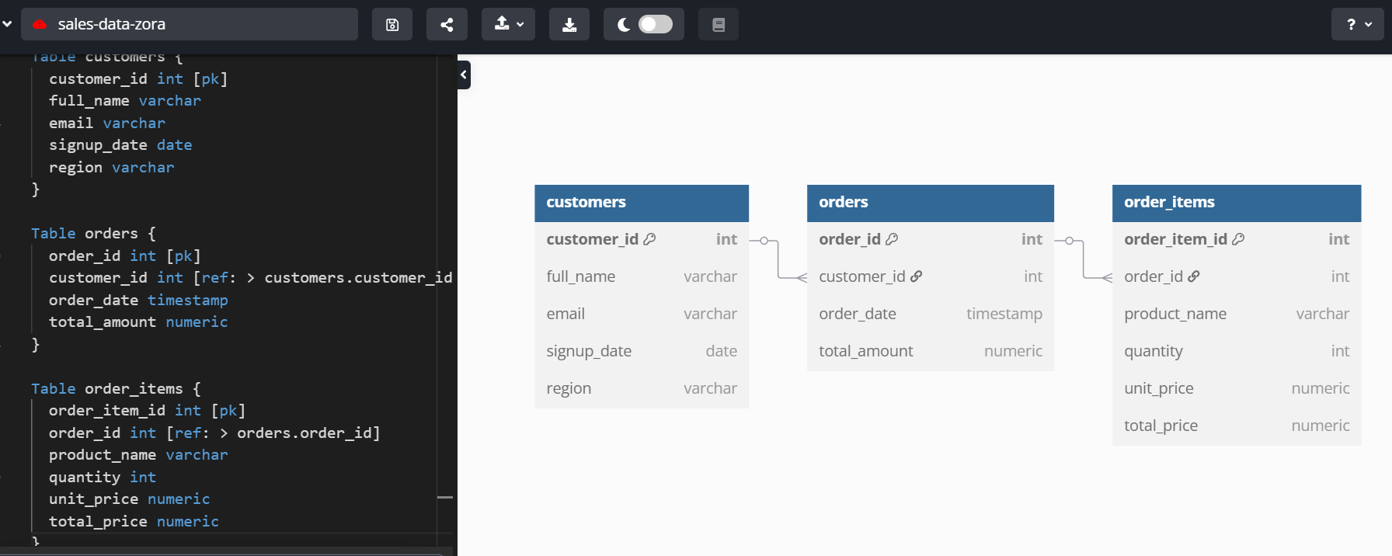

Slide 9
SQL INSIGHTS
Query 1: Top 5 best-selling products by revenue
Query 2: Total sales by region
Results captured in screenshots

Slide 10
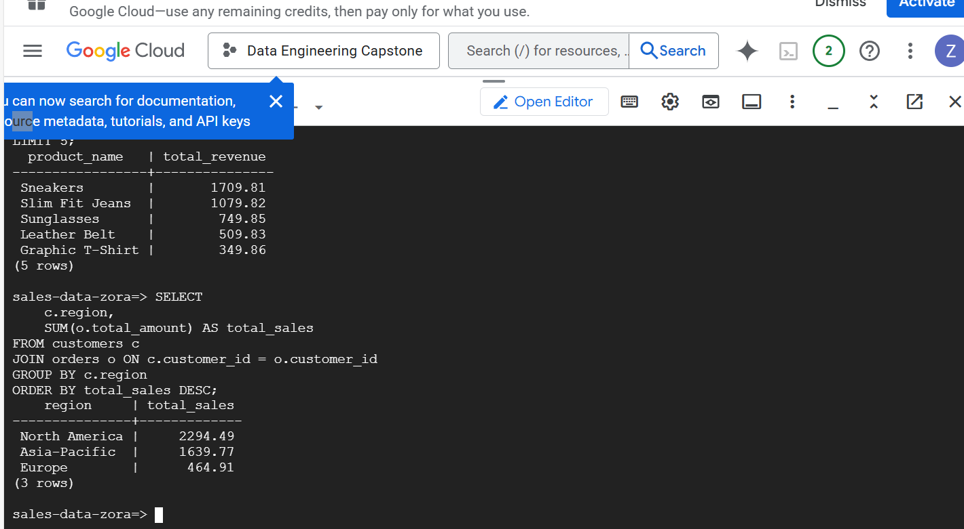

Slide 11
OUTCOME
Functional cloud-based data system
Successful ingestion and transformation pipeline
Insightful SQL queries produced

Slide 12
CHALLENGES
Overcoming GCP permissions and IP allowlisting
Working with Python and Google Cloud integration
Hands-on troubleshooting and cloud debugging

Slide 13
Thank you!

